Slide 1
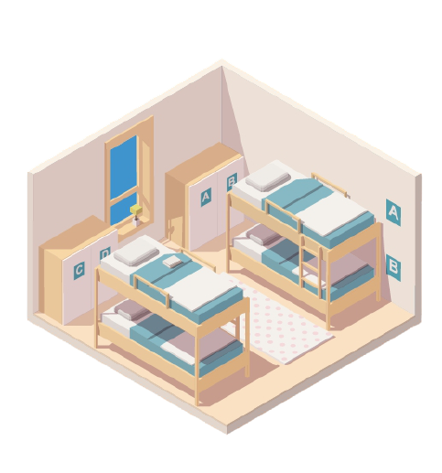


HOSTEL PORTAL SITE AND APPLICATION Submitted to KIIT Deemed to be University
In Partial Fulfillment of the Requirement for the Award
BACHELOR’S DEGREE IN COMPUTER SCIENCE & ENGINEERING
By
AVINAB SEN 1705298
DATTATRAYA DEB 1705304
NABANKUR DEY 1705418
SUPRIYO NANDI 1705470
RISHIRAJ SAXENA 1705353
MAYUKH MAJHI 1705323
UNDER THE GUIDANCE OF
PROF. BIRAJA ISAC
SCHOOL OF COMPUTER ENGINEERING
KALINGA INSTITUTE OF INDUSTRIAL TECHNOLOGY
BHUBANESWAR, ODISHA – 751024
DECEMBER 2020

Slide 2
INTRODUCTION
The purpose of this project to make an automated system to carry out different operations of a hostel. The system will provide the ease, comfort of use to the staff of the hostel by performing all work on computer system rather than following a paper pen approach. This approach helps improving the reliability of data maintained and provides a fast and efficient for the users of the website.
We have got seventeen hostels in our university, which consist of eleven boy’s hostel and six girl hostel. All these hostels at present are managed manually by the hostel office. The Registration form verification to the different data processing are done manually. Thus there are a lot of repetitions which can be easily avoided. And hence there is a lot of strain on the person who are running the hostel and software’s or websites are not usually used in this context. This particular project deals with the problems on managing a hostel and avoids the problems which occur when carried out manually.
Identification of the drawbacks of the existing system leads to the designing of computerized system that will be compatible to the existing system with the system which is more user friendly and more GUI oriented.
Hostel Management Portal is a customized and user friendly website for hostel which provide Hostel information, Hostel room information and Hostel accounts information.It helps admin to manage Student record, staff record generating report of students etc.

Slide 3
Abstract
e
Keywords: Hostel Portal, Management, Student Allocation, Data Consistency, Upcoming events, Chat bot, Contact us
As the name specifies “HOSTEL PORTAL” is a software developed for managing various activities in the hostel. For the past few years the number of educational institutions are increasing rapidly. Thereby the number of hostels are also increasing for the accommodation of the students studying in this institution. And hence there is a lot of strain on the person who are running the hostel and software’s are not usually used in this context. This particular project deals with the problems on managing a hostel and avoids the problems which occur when carried manually. Identification of the drawbacks of the existing system leads to the designing of computerized system that will be compatible to the existing system with the system Which is more user friendly and more GUI oriented. We can improve the efficiency of the system, thus overcome the drawbacks of the existing system.
Less human error
Strength and strain of manual labour can be reduced High security
Data redundancy can be avoided to some extent
Data consistency
Easy to handle
Keywords: Hostel Portal, Management, Student Allocation, Data Consistency, Upcoming events, Chat bot, Contact us

Slide 4
Literature Survey
Hostel management system development using PHP program has lots of codes. Using Internet in gathering information partially contributed to the success of this project. Due to the fact that PHP is an open source program, development of hostel management system was not too difficult. However, thanks to the cyber world (Internet) that makes it possible to study and make comparison in needs of some code function. A number of hostel portal system documents were examined and compared to the need of KIIT’s proposed hostel portal system. Among other web site that was used in my research is “ http://freesourcecode.com/ ”. It provided me with various lines of codes which I used in the developmental process of this project.
“A review of PHP Compilers and Outputs” Favre, Nicolas (2010-02-16) - gave a good layout of product design.
Personal Home Page Tools (PHP Tools) Lerdorf, Rasmus (1995-06-08), was very helpful and insightful in the product development of this project.
W3schools have prototypes that helped building interfaces for the project.

Slide 5
SOFTWARE REQUIREMENT SPECIFICATION FUNCTIONAL REQUIREMENTS:
LOGIN
The website/app allows a visitor to login by authenticating whether the user is a hosteller student or a warden of the designated hostel.
The hosteller has a dedicated account which is mapped to his/her respective User ID and Password by the system.
The system allows an account holder to change the password used for logging in.
All the wardens share a common account dedicated only to a particular hostel or block.
STUDENT PROFILE
The system allows a hosteller to view and update his/her details in the My Profile section.
The hosteller is also able to see the Mess Menu which is updated as per the season and accompanied by the availability of regional foods.
The hosteller can view the hostel details wherein there is the list of wardens and their contact details, room details and Hostel name of the hosteller.
The system also allows the hosteller to check out the facilities available in their respective hostels.

Slide 6
COMPLAINT:
ü The system allows a hosteler to raise complaints where each complaint associated is given an ID and stored in the database.
ü Once an warden resolves a complaint, the system marks it as approved.
ü The wardens of the designated hostel is allowed to view the approved / disapproved complaints as the system keeps track of the raised complaints.
ü The hostelers may request to change rooms or report any other issues related to the particular hostel.

Slide 7
SOFTWARE INTERFACES (TOOLS & TECHNOLOGIES USED)
The software is developed with all the basic controls and class provided in JAVA and SQL, Windows XP or above installed on the system. Application package must be installed.
Operating system : Windows 10.
Front End tools : PHP as scripting language
Back End: SQL Server
Client Side: HTML,CSS,Bootstrap and Javascript(ES-5).
Hyper-Text Markup Language :
HTML elements forms the building blocks of all websites, allows Image sand objects to be embedded and can to be used to create interactive forms. It provides a means to create structured documents by denoting structural semantics for txt such as heading, paragraphs, lists, links, quotes and so on. It can also embed scripts written in languages such as JavaScript which affect the behavior of HTML web pages.

Slide 8
Cascading Style Sheets :
CSS is a style sheet language used for describing the look and formatting of a document written in a markup language. While most often used to style web pages and interfaces written in HTML and XHTML, the language can be applied to any kind of XML document, including plain XML, SVG and XUL. CSS is designed basically to enable the separation of document content from document presentation, including elements such as layout,colors and fonts.
Bootstrap :
Bootstrap is a web framework that focuses on simplifying the development of informative web pages (as opposed to web apps). The primary purpose of adding it to a web project is to apply Bootstrap's choices of color, size, font and layout to that project. As such, the primary factor is whether the developers in charge find those choices to their liking. Once added to a project, Bootstrap provides basic style definitions for all HTML elements.
PHP (Hypertext Preprocessor) :
PHP is a popular general-purpose scripting language that is especially suited to web development. PHP code is usually processed on a web server by a PHP interpreter implemented as a module, a daemon or as a Common Gateway Interface (CGI) executable. On a web server, the result of the interpreted and executed PHP code – which may be any type of data, such as generated HTML or binary image data – would form the whole or part of a HTTP response.

Slide 9
SQL (Structured Query Language) :
To work with data in a database, you must use a set of commands and statements (language) defined by the DBMS software. There are several different languages that can be used with relational databases; the most common is SQL.
Javascript :
JavaScript, often abbreviated as JS, is a programming language that conforms to the ECMAScript specification. JavaScript is high-level, often just-in-time compiled, and multi-paradigm. It has curly-bracket syntax, dynamic typing, prototype-based object-orientation, and first-class functions.It is used to make the page dynamic
XAMPP Server :
XAMPP is a free and open-source cross-platform web server solution stack package developed by Apache Friends, consisting mainly of the Apache HTTP Server, MariaDB database, and interpreters for scripts written in the PHP and Perl programming languages.

Slide 10
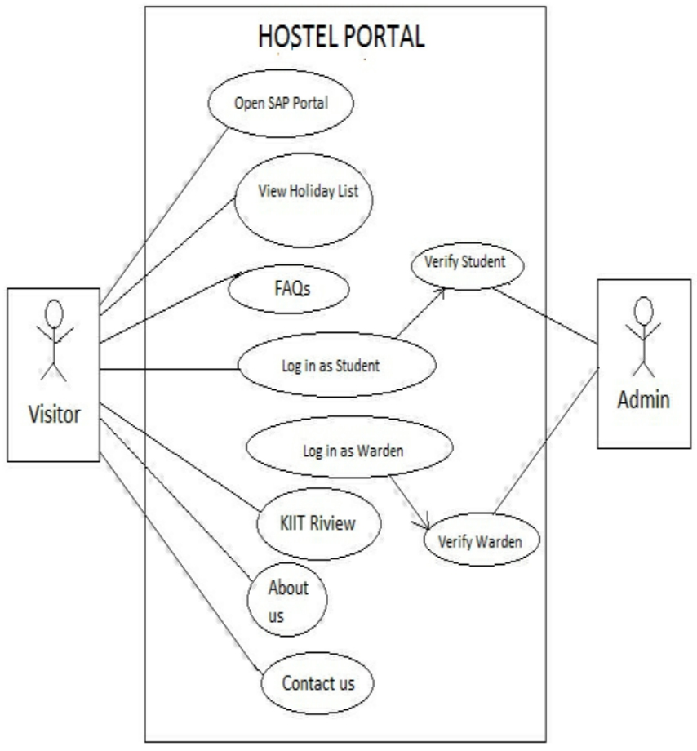
SYSTEM DESIGN
USE CASE DIAGRAMS
STUDENT LOGIN:
A UML use case diagram is the primary form of system/software requirements for a new software program underdeveloped.here the use case diagram shows the students can login and register their complaints. Hostel Portal for Student Login

Slide 11
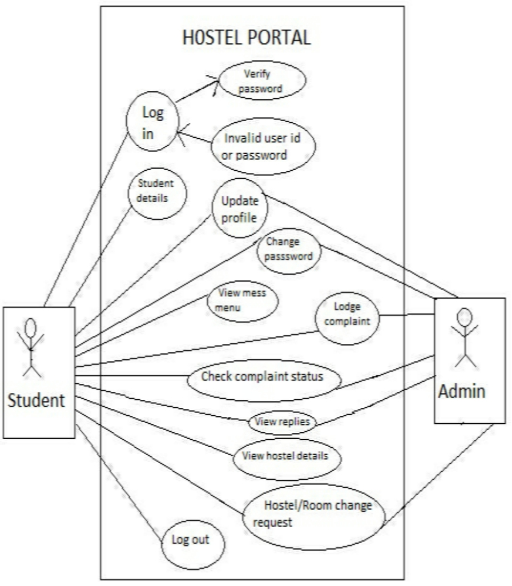
WARDEN LOGIN
Now comes the part where the warden logins first to see all the complaints submitted which is shown in the dashboard.

Slide 12
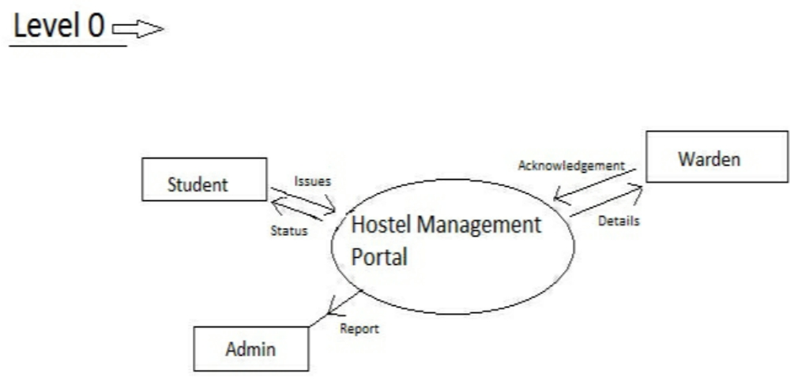
DATA FLOW DIAGRAMS
Process design plays an important role in project development. In order to understand the working procedure, process design is necessary. Data Flow Diagram and System Flow chart are the tools used for process design. Data Flow Diagram is the logical representation of the data flow of the project. The DFD is drawn using various symbols. It has a source and a destination. The process is represented using circles and source and destination are represented using squares. The data flow is represented using arrows. One reader can easily get the idea about the project through Data Flow Diagram.

Slide 13
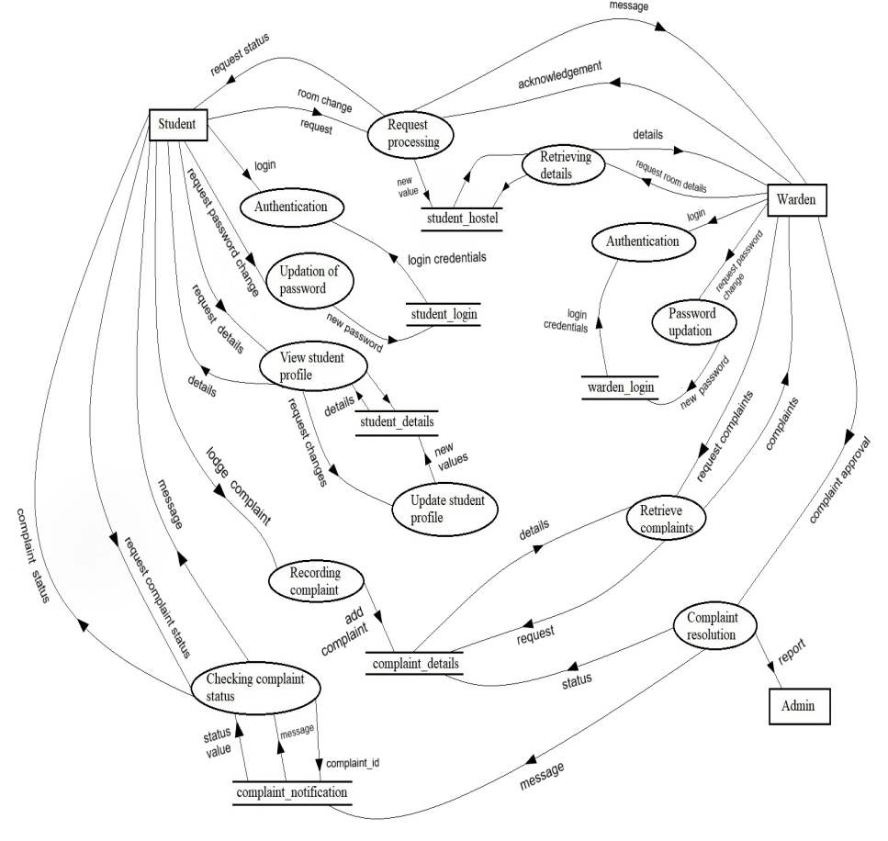
LEVEL 1

Slide 14
PICTURES OF IMPLEMENTATION
In this Application we have two types of user: Student and Warden.
Student and Warden can Login to portal by their UserId and Password.
The Student can see their profile ,hostel details and they can complain to warden via app to respective hostel wardens. And warden basically review that complain can take required actions.

Slide 15
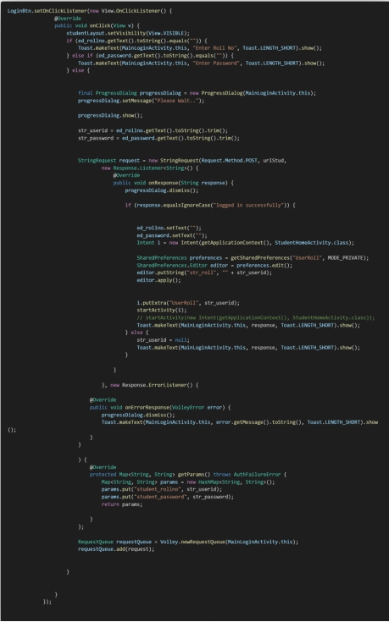
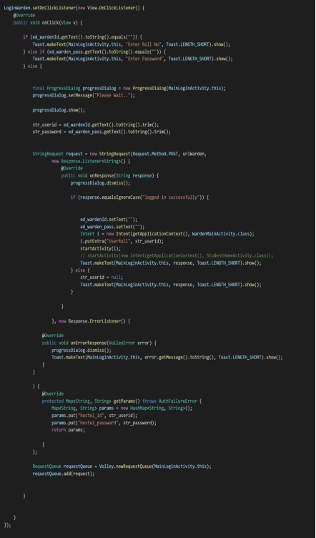
CODE FOR LOGIN
ANDROID APP

Slide 16
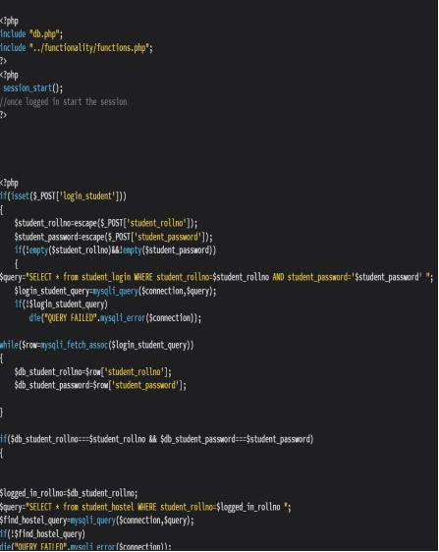
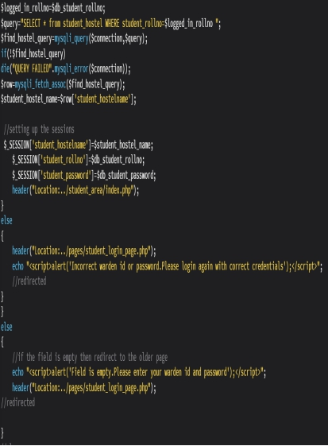
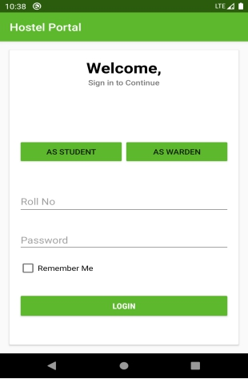
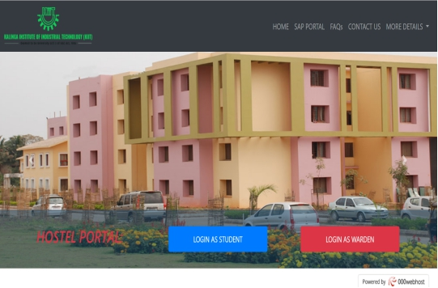

Slide 17
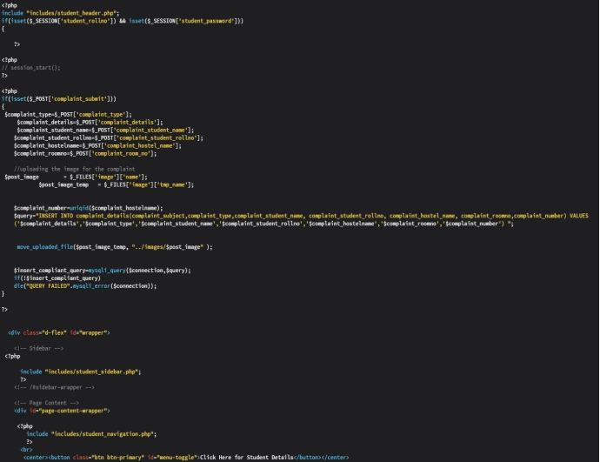
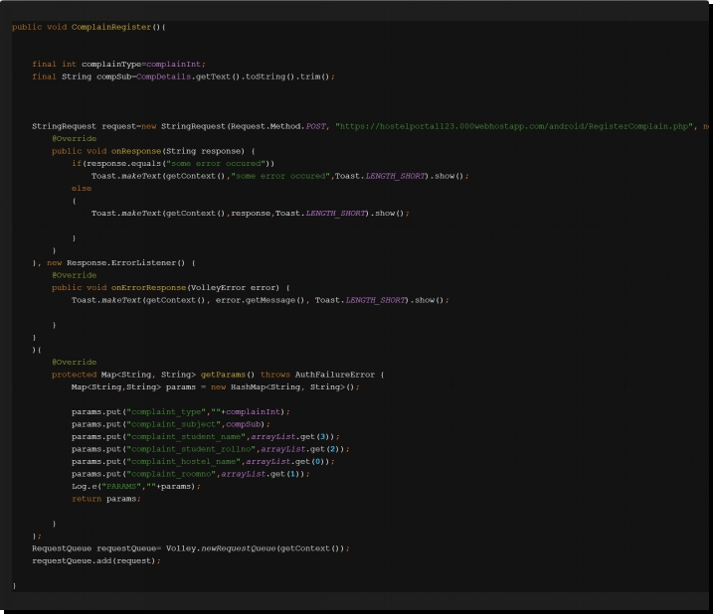
WEBSITE
CODE FOR COMPLAINT
ANDROID APP

Slide 18
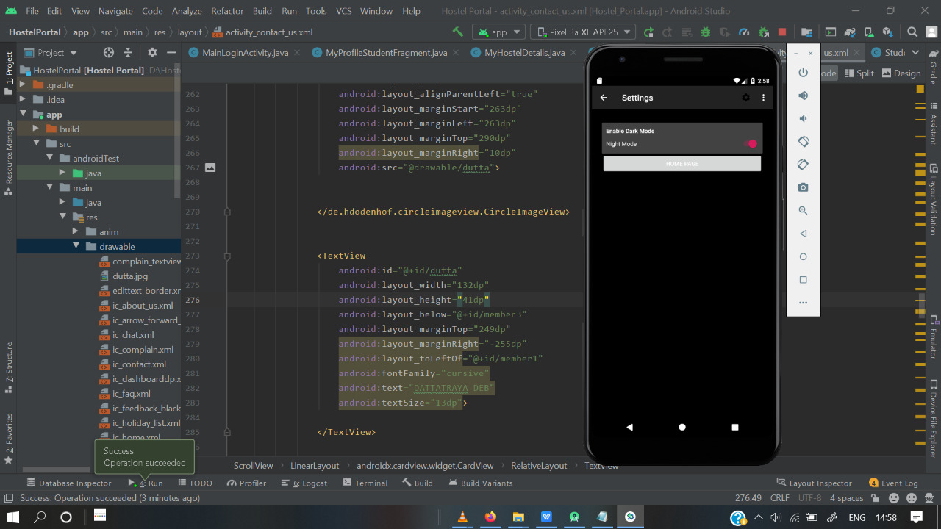
Code for Dark Mode Android App

Slide 19
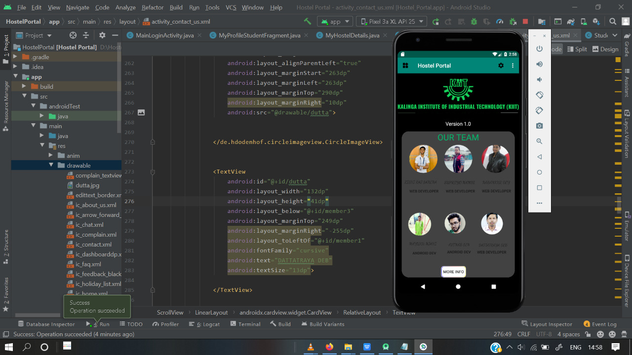

Slide 20
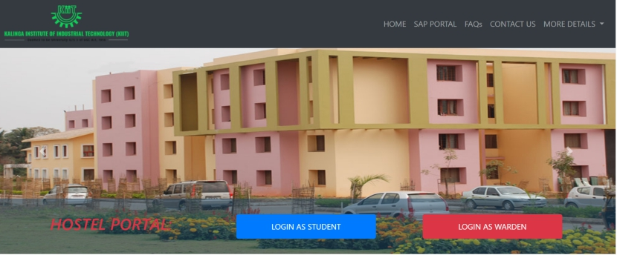
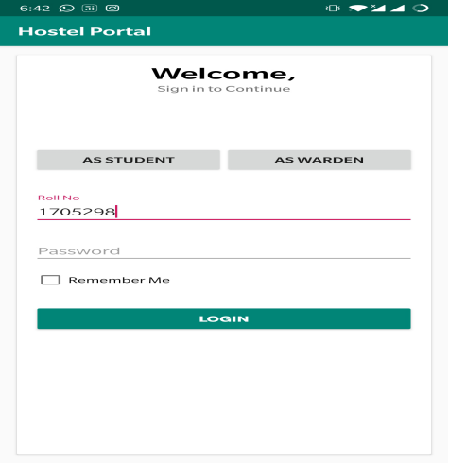
WEBSITE AND APP SCREENSHOTS
LOGIN SCREEN

Slide 21
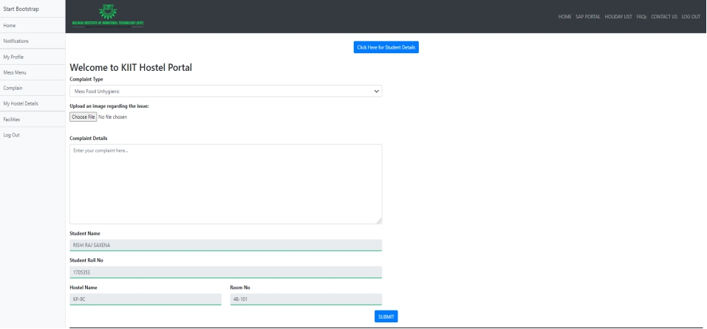
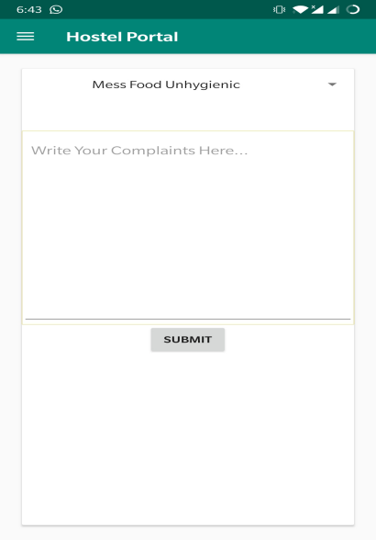
COMPLAIN BOX

Slide 22
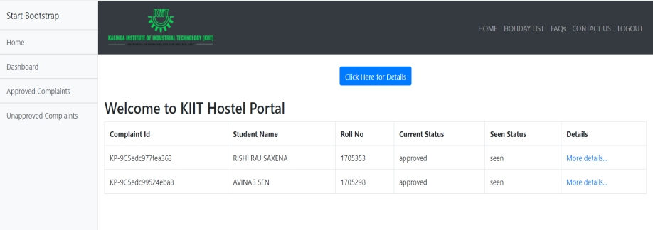
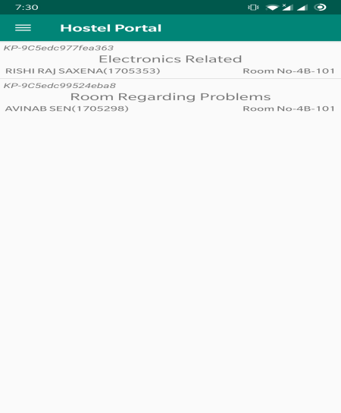
DASHBOARD

Slide 23
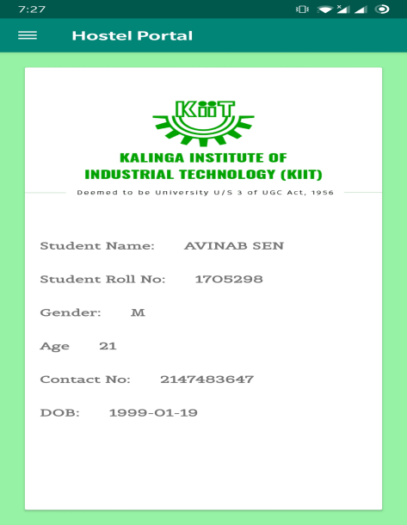
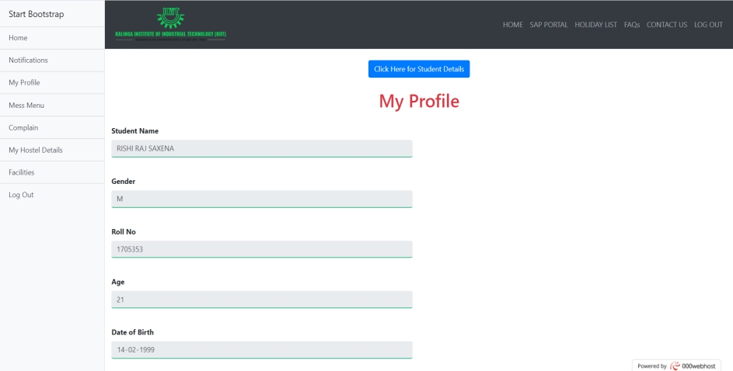
STUDENT PROFILE

Slide 24
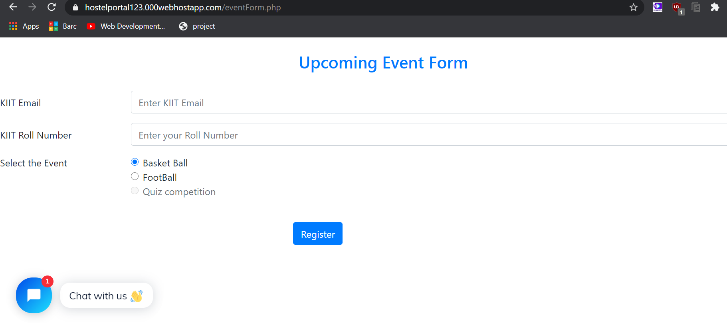
Upcoming Events

Slide 25
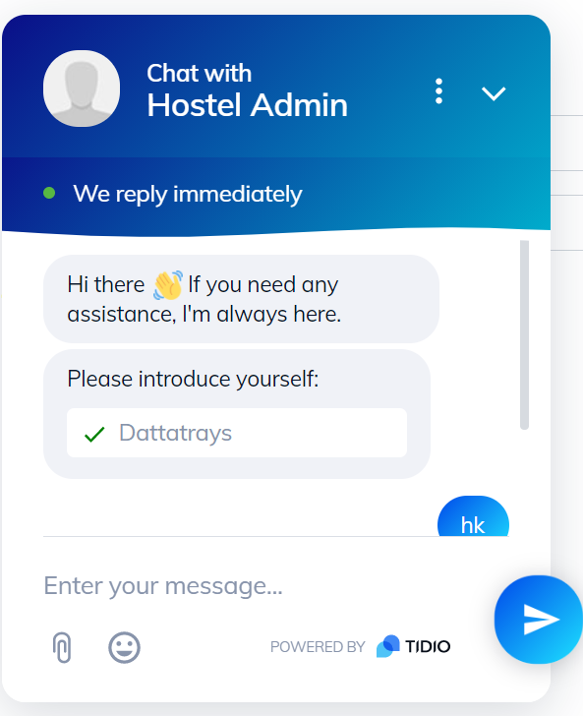
Chatbot

Slide 26
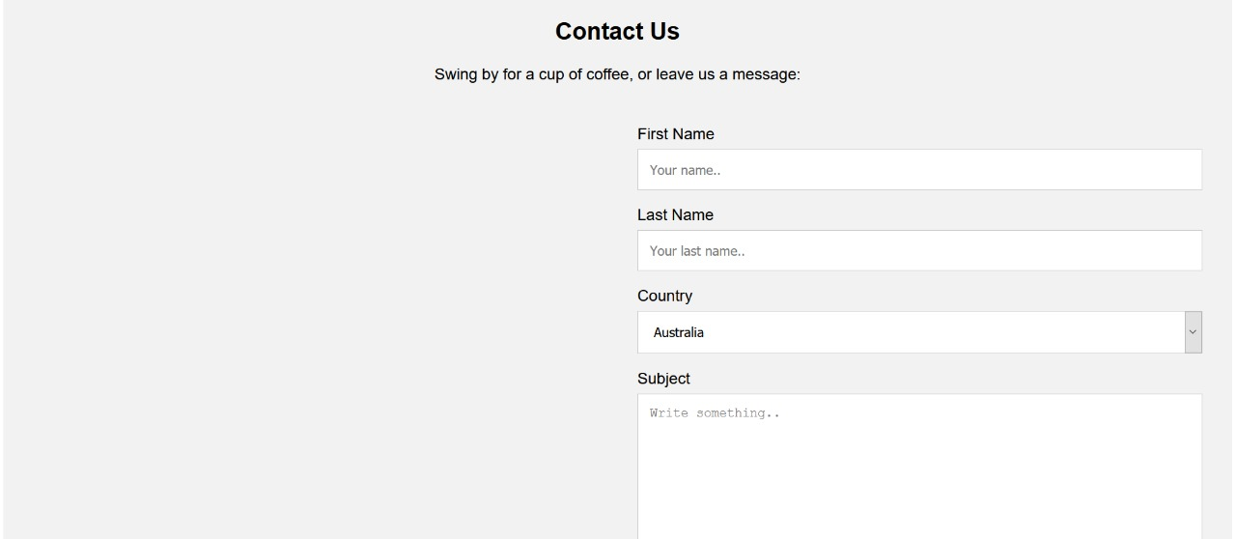
Contact Us

Slide 27
CONCLUSION
The project, developed using PHP with SQL SERVER and various front end tools technologies which is based on the software’s requirement specification of the user and the analysis of the existing system, with flexibility for future enhancement.
ONLINE HOSTEL MANAGEMENT PORTAL is very helpful for hostel allotment and mess fee calculation and information regarding pupils accessing the premises. This hostel management software is designed for people who want to manage various activities in the hostel perspective.In past few years the number of educational institutions are increasing rapidly which resulted in number of hostels are also increasing for the accommodation of the students studying in a particular institution, hence there is a lot of strain on the person who is running the hostel since software’s or websites are not usually used in this context.
This particular project deals with the problems on managing a hostel resulting in eradicating the problems that occur when carried manually. Identification of the drawbacks of the existing system leads to the designing of computerized system that will be compatible to the existing system with the system which is more user friendly and more GUI oriented.

Slide 28
FUTURE SCOPE
This Hostel Portal Management System would help the admins/end user with instantaneous updated information regarding any student/warden/worker in the current hostel premises hence reducing the opacity that has been a concern in the previous generation.The Portal System enables each student to put up a query at point of time(if any) regarding an issue he/she is facing with the warden obliged to look after the situation and find a solution to it. The transparency of the system helps in authorizing every situation without any compromise or faulty execution from misleading or unforeseen future.
1. Instantaneous Queries
2. Proficient agreement
3. Transparency in Co-operation.

Slide 29

THANK YOU

